Slide 1


CAPSTONE PROJECT
Fake News Detection
Presented By
Student Name: ADDEPALLI SUBASH
College Name: KLH UNIVERSITY BOWRAMPET HYDERABAD
Department: CSE
Email ID: addepallisubash@gmail.com

Slide 2
OUTLINE:
Problem Statement
Proposed System/Solution
System Development Approach (Technology Used)
Algorithm & Deployment
Result (Output Image)
Conclusion
Future Scope
References

Slide 3
Problem Statement:
With the rapid growth of digital media and online communication platforms, massive volumes of textual information are generated every day. This data comes from news articles, blogs, social media posts, and other digital sources. Managing and analyzing such large-scale textual data has become increasingly challenging.
Manually reviewing and categorizing this information is not only time-consuming but also prone to human error and inconsistency. As the amount of text data continues to grow, traditional manual methods become inefficient and impractical.
Therefore, handling, organizing, and accurately classifying large volumes of text data remains a significant challenge in the modern digital environment.

Slide 4
Proposed Solution:
The proposed system aims to automatically classify textual data using Natural Language Processing (NLP) and Machine Learning techniques. The system analyzes text content and predicts its category based on learned patterns.
• Data Collection: Use the 20 Newsgroups dataset containing labeled text documents, Extract text data and corresponding category labels.
• Data Preprocessing: Clean and prepare textual data for analysis, Convert multi-class labels into binary classification.
• Feature Extraction: Apply TF-IDF vectorization to convert text into numerical form. Identify important words and their significance in documents.
• Machine Learning Algorithm: Implement Logistic Regression for classification. Train the model using the processed training dataset.
• Model Evaluation: Measure model performance using accuracy score. Generate a confusion matrix to analyze prediction results.
• Deployment: Develop and execute the model in Google Colab. Enable prediction for new custom text inputs.

Slide 5
System Approach:
The system development approach describes the overall methodology used to design and implement the text classification model.
• System Requirements:
Google Colab environment for development and execution.
Python programming language.
• Libraries Required:
Pandas and NumPy for data handling.
Scikit-learn, Matplotlib, and Seaborn for model building and visualization.
• Development Process:
Split dataset into training and testing sets (80% - 20%).
Convert text data into numerical features using TF-IDF.
• Model Implementation:
Train Logistic Regression model on training data.
Evaluate performance using testing data.

Slide 6
Algorithm & Deployment:
• Algorithm Selection:
Logistic Regression is used for binary text classification.
It predicts the probability of a text belonging to a particular category.
• Data Input:
Input consists of textual documents from the dataset.
TF-IDF features are used as numerical input to the model.
• Training Process:
The model is trained using 80% of the dataset.
It learns patterns and relationships between words and labels.
• Prediction Process:
The trained model predicts labels for unseen test data.
It can also classify new custom text inputs.
• Deployment:
The model is implemented and executed in Google Colab.
Web deployment is optional and not mandatory.

Slide 7
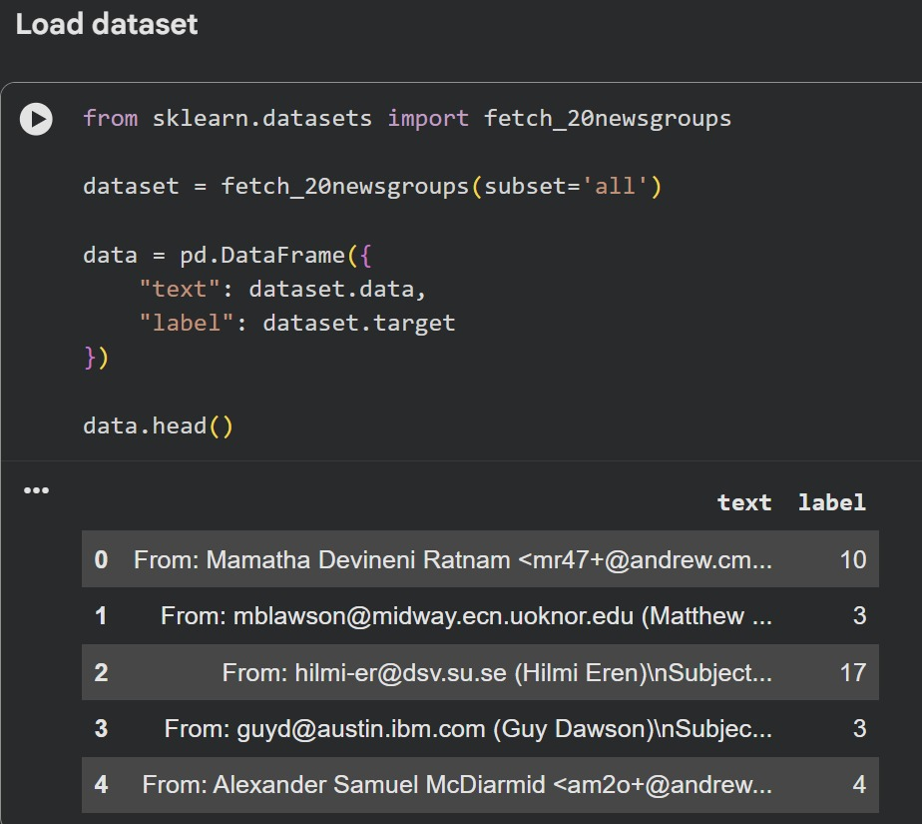
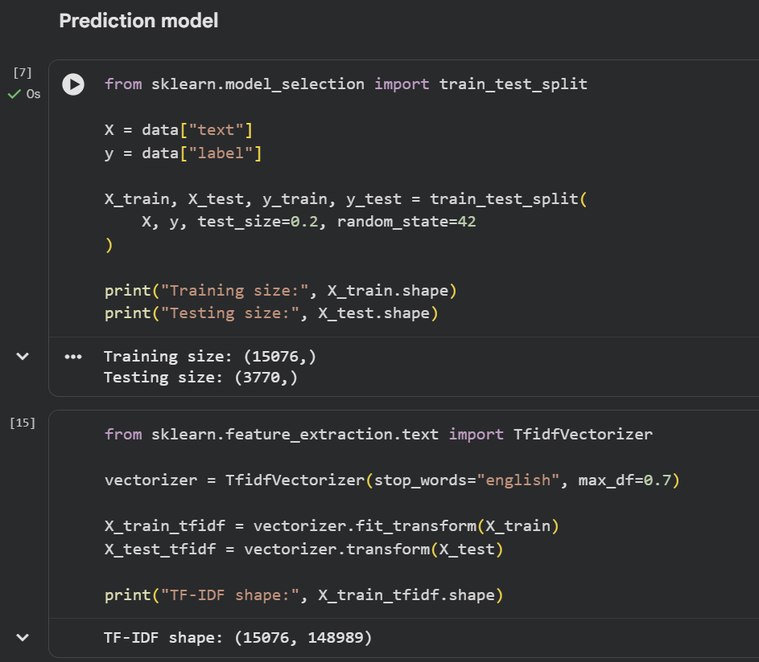
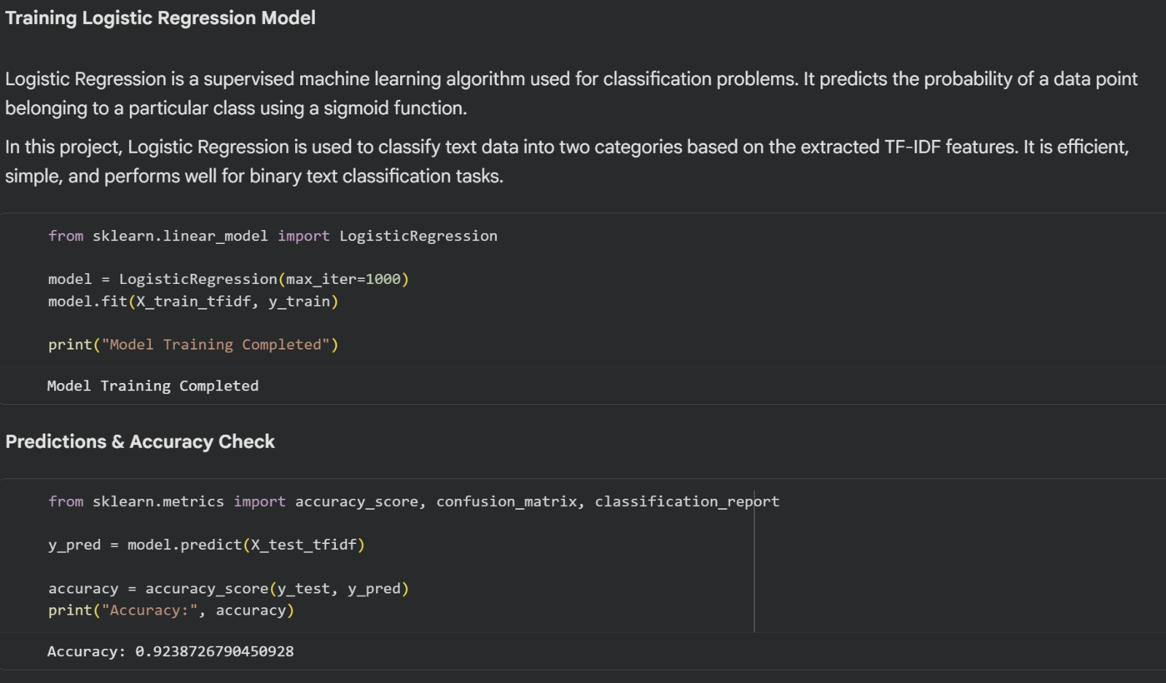
Result:
The developed model was evaluated using accuracy score and confusion matrix. The Logistic Regression model achieved an accuracy of 92.38%, demonstrating strong performance in text classification.

Slide 8
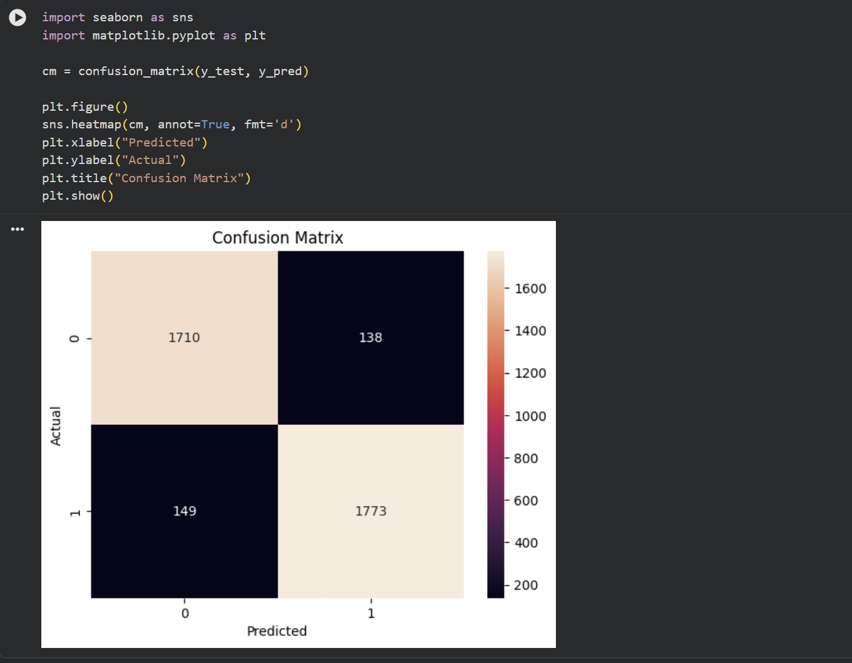
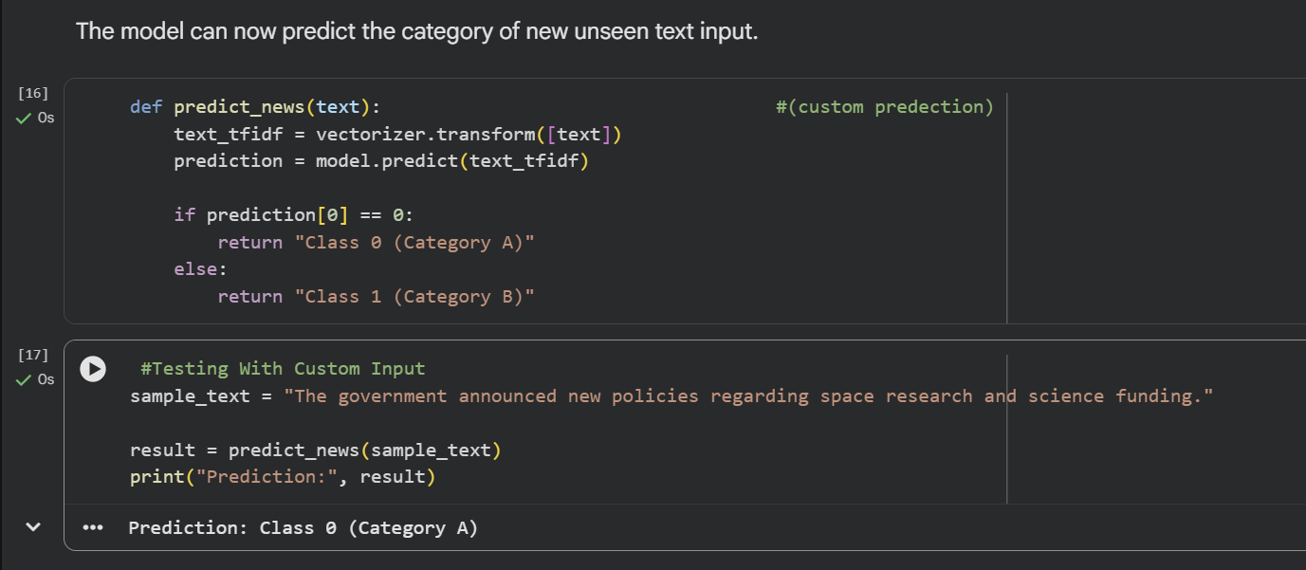
Result:

Slide 9
Conclusion:
The project successfully developed a text classification model capable of automatically analyzing and categorizing textual data. The Logistic Regression model achieved an accuracy of 92.38%, demonstrating strong performance.
The implementation shows that automated text classification can significantly reduce manual effort and improve efficiency in handling large volumes of textual information.
The model effectively learned patterns from textual data and classified unseen text with high accuracy.
The approach demonstrates the practical application of Machine Learning in real-world text analysis tasks.

Slide 10
Future scope:
Improve accuracy using advanced deep learning models such as LSTM or BERT.
Expand the system to handle multi-language text classification.
Integrate the model into a web or mobile application for real-time usage.
Use larger and more diverse datasets to enhance model performance.
Implement real-time monitoring and continuous model improvement using new incoming data.

Slide 11
References:
Scikit-learn Official Documentation – https://scikit-learn.org
Python Official Documentation – https://www.python.org
20 Newsgroups Dataset – Scikit-learn Built-in Dataset
Research articles on Text Classification and Machine Learning
GitHub Link: https://github.com/a-subash/AICTE-Fake-News-Detection-Project

Slide 12
Thank You

